Slide 1
5. Sequence Diagram- Prod
Use this space for your Sequence Diagram (refer to the example documents if needed)
“A sequence diagram consists of a group of objects that are represented by lifelines, and the messages that they exchange over time during the interaction. A sequence diagram shows the sequence of messages passed between objects. Sequence diagrams can also show the control structures between objects.” - IBM
| | | | |
| Login | | | |
|----------------------------------> | | | |
| | | | |
| Run Flow | | | |
|----------------------------------> | | | |
| |Capture Username | | |
| |----------------> | | |
| | Launch EXE | | |
| |-------------> | | |
| | | Display UI | |
| <--------------------------------- | | |
| Enter Details | | | |
|----------------------------------> | | | |
| | | Generate Docs | |
| | |--------------------------------> | Save Files |
| | |<--------------------------------- | |
| | Wait for Completion | | |
| |<----------------- | | |
| |----------------------------------------------------------------------------------------------------------------------- |Send Email
| |<-------------------------------------------------------- ------------------------------------------------------------ -|
| Show Success | | | |
|<------------------------------------ | | | |
User
PAD Flow
Python App
OneDrive
Outlook

Slide 2
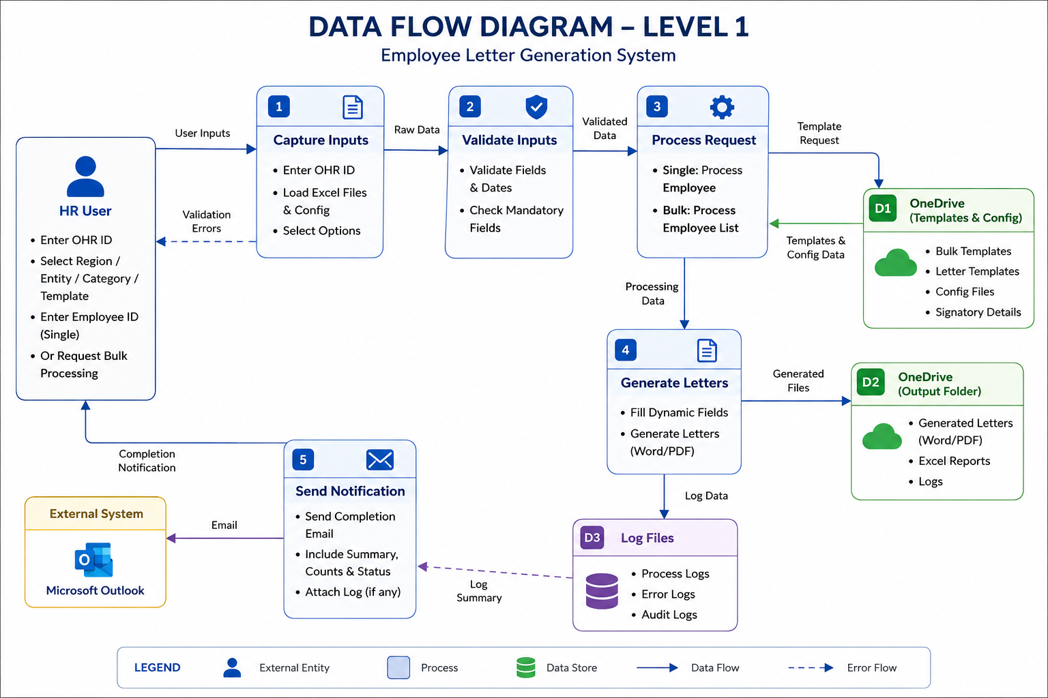
6. Data flow diagram
Use this space for your Data Flow Diagram (refer to the example documents if needed)
“A data flow diagram (DFD) maps out the flow of information for any process or system. It uses defined symbols like rectangles, circles and arrows, plus short text labels, to show data inputs, outputs, storage points and the routes between each destination.” - LucidChart

